Slide 1

Ad Hoc Insights
Consumer Goods
Saksham Angane

Slide 2
Objectives
Atliq Hardware (fictitious corporation) is one of the major computer hardware manufacturers in India, with a strong presence in other nations.
Nevertheless, the management did note that they do not have sufficient insights to make prompt, wise, and data-informed judgments.
Plan to expand the data analytics team by adding junior data analysts.
To assess candidates, Data analytics director, Tony Sharma plans to conduct a SQL challenge to evaluate both tech and soft skills.
The company seeks insights for 10 ad hoc requests.

Slide 3
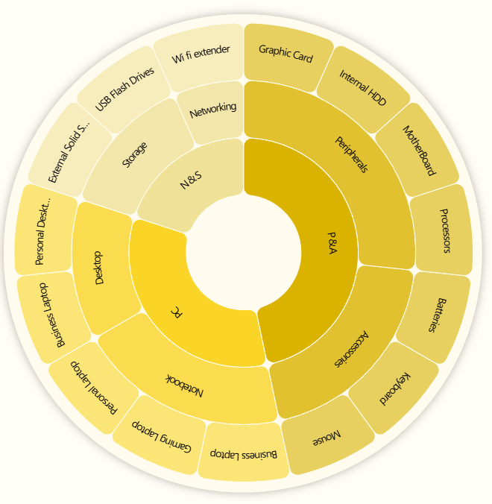
Company Details
Atliq Hardware is a computer hardware and accessory manufacturer.
Outer Circle:
Category
Fiscal Year
September 2019 – August 2020
FY 2020
September 2020 – August 2021
FY 2021
Mid Circle:
Segment
Inner Circle:
Division

Slide 4

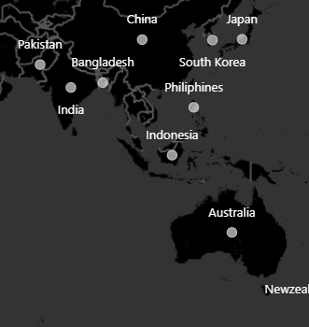
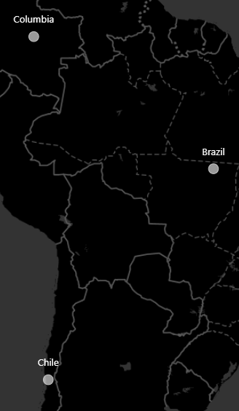
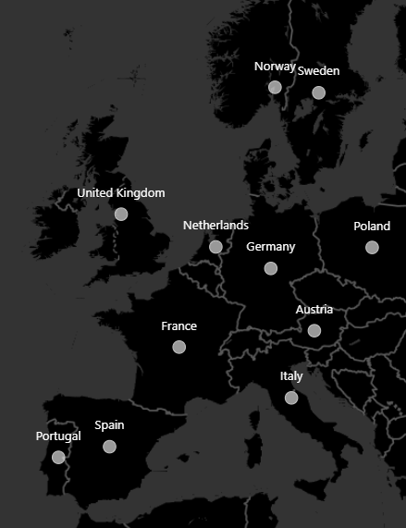
Company’s Market
NA
Latin AM
EU

Slide 5
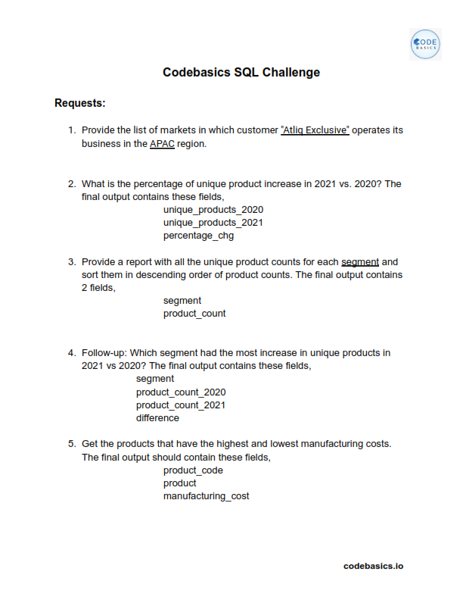
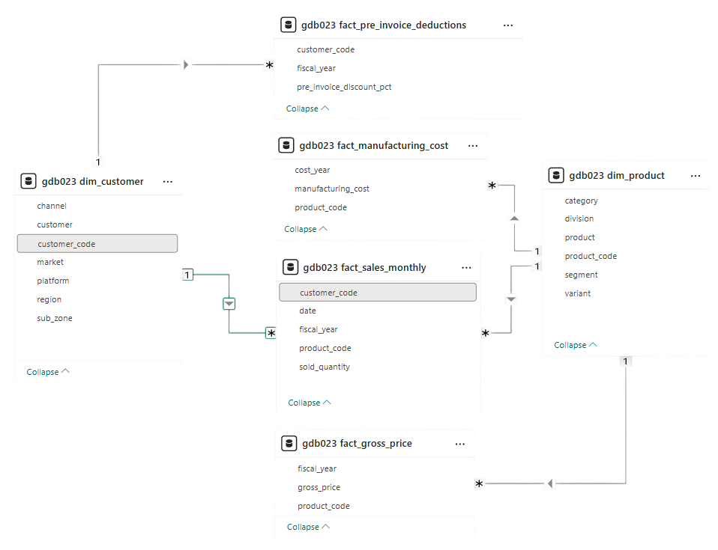
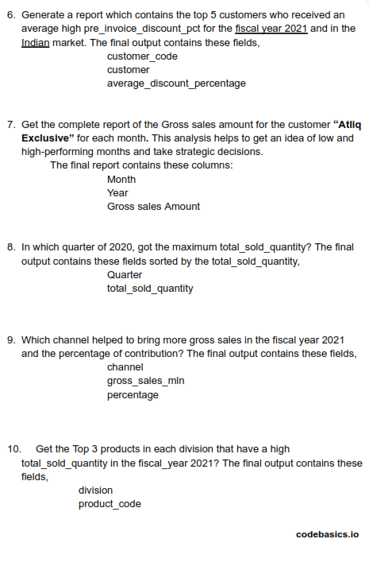


Data, Requests and Tools
For Analysis and visualization:

Slide 6
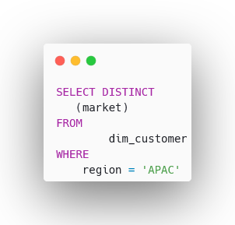
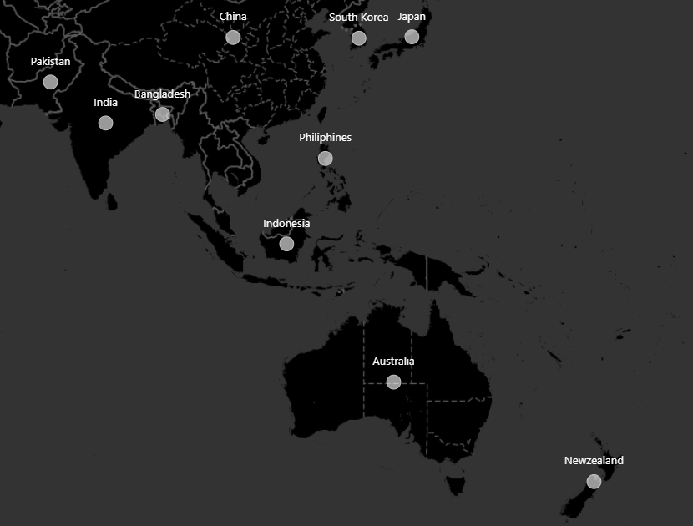
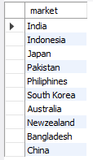
1. Provide the list of markets in which customer "Atliq Exclusive" operates its business in the APAC region.
Atliq Exclusives
marketing countries in
APAC region

Slide 7
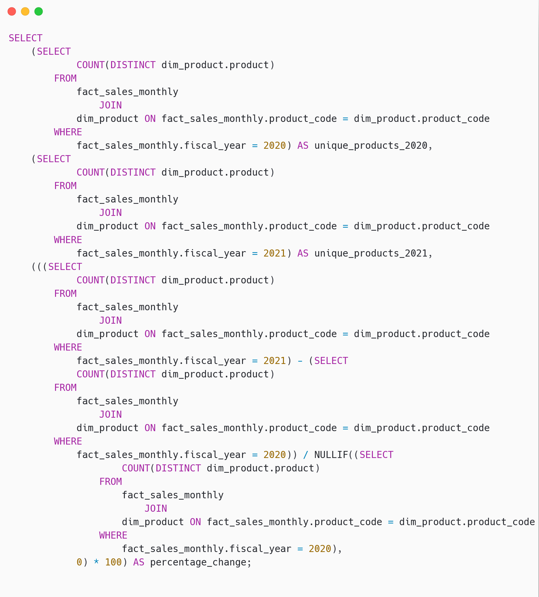

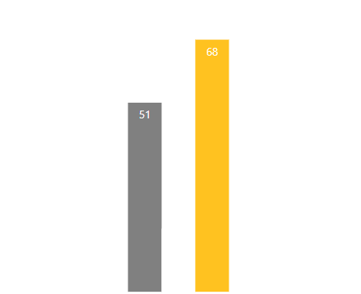
2.What is the percentage of unique product increase in 2021 vs. 2020? The final output contains these fields, unique_products_2020 unique_products_2021 percentage_chg
Unique products 2020
Vs
Unique products 2021
Percentage
change 33.33%
17
Insight:
Demand and production both increased

Slide 8
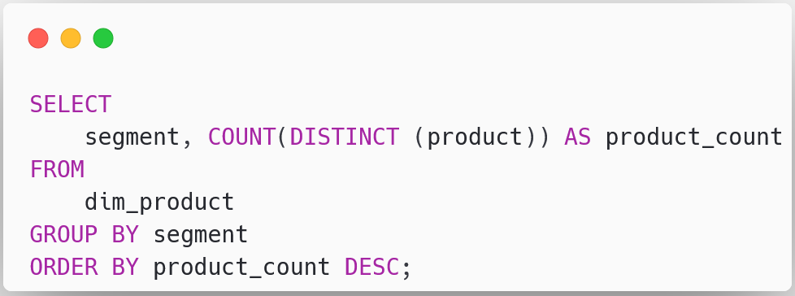
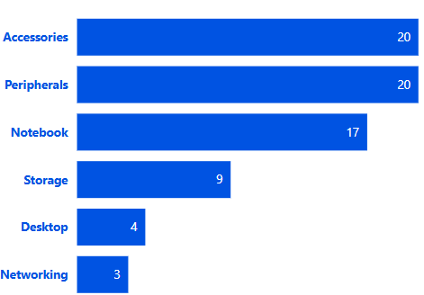
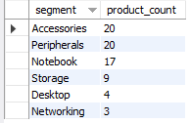
3. Provide a report with all the unique product counts for each segment and sort them in descending order of product counts. The final output contains 2 fields: segment, product_count
Unique product count for each segment
Insights:
Segments: notebooks, accessories, and peripherals are showing significant manufacturing growth as compared to desktops, storage, and networking.
Notebooks, accessories, and peripherals constitute 83% of the total manufactured product.

Slide 9
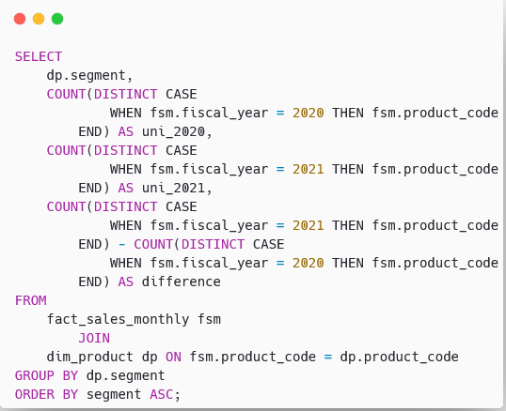
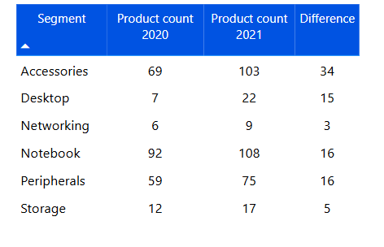
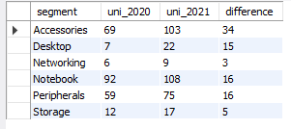
4. Follow-up: Which segment had the most increase in unique products in 2021 vs 2020? The final output contains these fields, segment, product_count_2020, product_count_2021, difference
Unique product difference per segment from 2020 to 2021
Insights:
Accessories had the largest increase in production.
Storage and networking are experiencing slower production growth than other segments.

Slide 10
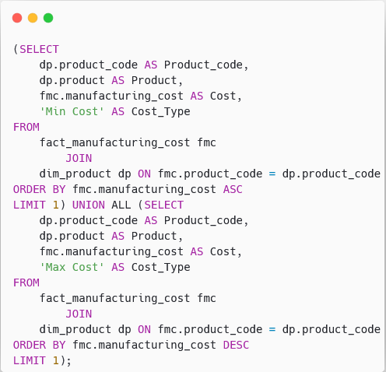
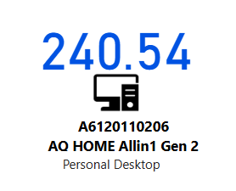
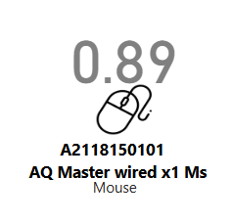

5. Get the products that have the highest and lowest manufacturing costs. The final output should contain these fields, product_code, product manufacturing_cost
Products having the highest and lowest manufacturing costs
Insights:
Mouse: AQ Master wired x1 Ms (Variant: Standard 1) has the lowest manufacturing cost.
Personal Desktop: AQ Home Allin1 Gen2 (Variant: Plus 3) has the highest manufacturing cost.

Slide 11
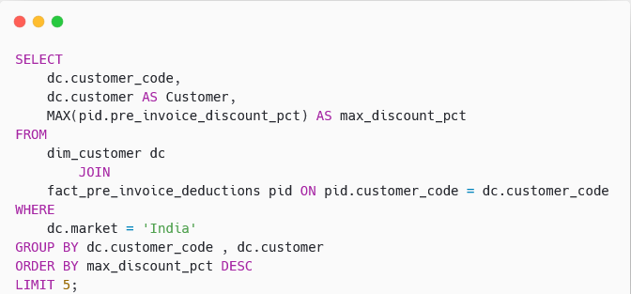
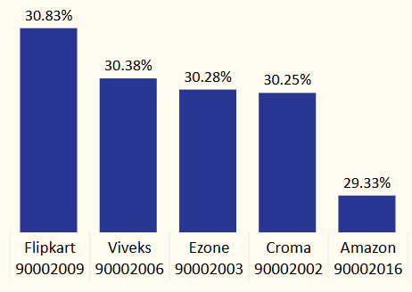
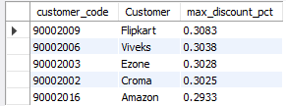
6. Generate a report which contains the top 5 customers who received an average high pre_invoice_discount_pct for the fiscal year 2021 and in the Indian market. The final output contains these fields: customer_code, customer, average_discount_percentage
Top 5 Indian customers with
highest average discount
percentage for FY 2021
Insights:
The largest average pre-invoice discount was given to Flipkart.
The least average pre-invoice discount was given to Amazon.

Slide 12
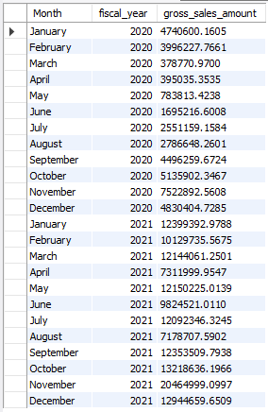
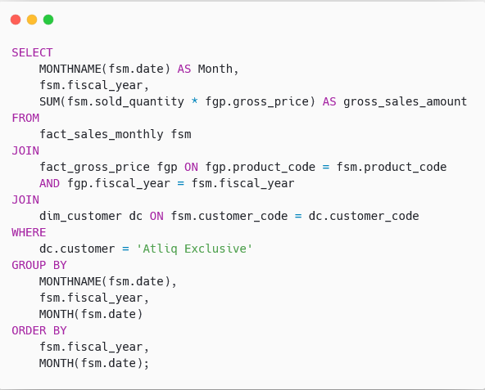
7. Get the complete report of the Gross sales amount for the customer “Atliq Exclusive” for each month . This analysis helps to get an idea of low and high-performing months and take strategic decisions. The final report contains these columns: Month, Year, Gross sales Amount
Insights:
The lowest Gross sales total for both fiscal years is in March (2020).
The highest Gross sales total for both fiscal years is in November (2020).
73.8% of the total Gross sales figure is in FY 2021.

Slide 13
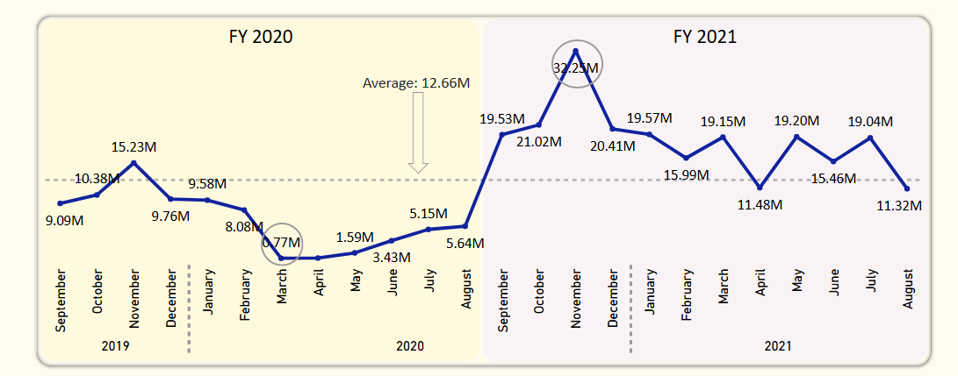
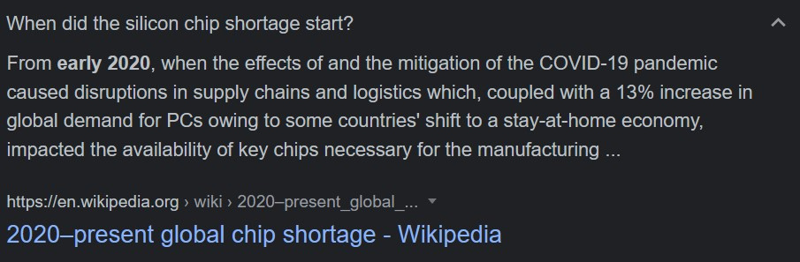
Reasons:
COVID-19
Global Chip shortage

Slide 14
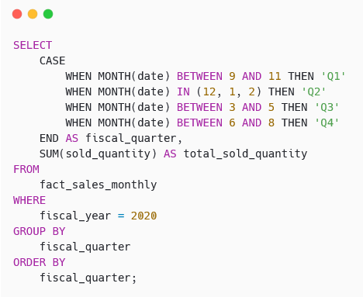
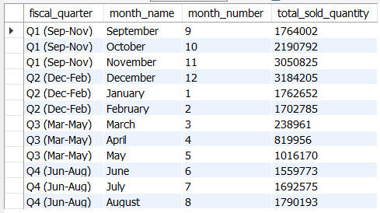

8. In which quarter of 2020, got the maximum total_sold_quantity? The final output contains these fields sorted by the total_sold_quantity, Quarter, total_sold_quantity
Insights:
Quarter 1 of FY2020 saw the most units sold overall, while Quarter 3 had the fewest.
The highest and lowest overall sold quantity is in December and March. Quarter 1 accounts for approximately 34% of the total sold quantity for FY2020

Slide 15
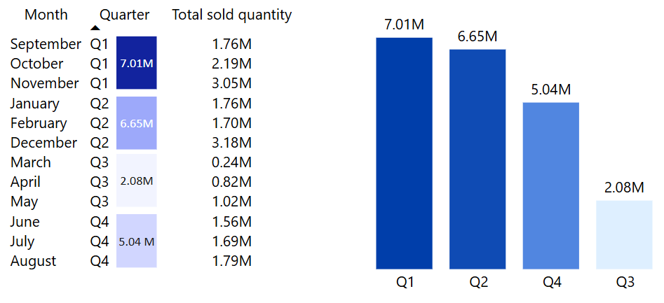
Total sold quantity in FY 2020 by Quarter

Slide 16
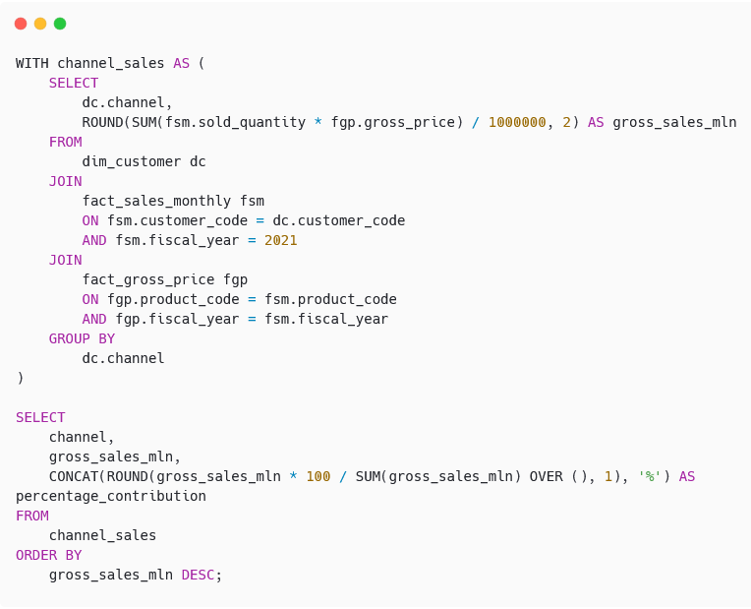
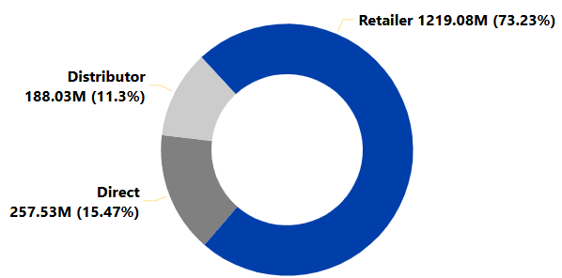

9. Which channel helped to bring more gross sales in the fiscal year 2021 and the percentage of contribution? The final output contains these fields: channel, gross_sales_mln, percentage
Gross sales and contribution percentages by Channels for FY 2021
Insights:
Channel: "Retailer" helped bring maximum sales to the company with 73.22% as the contribution percentage.
Channel: "Distributor" makes the least contribution at a percentage of 11.31%.

Slide 17
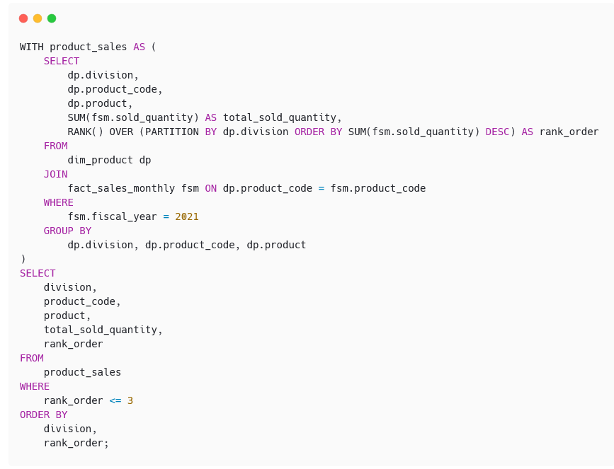
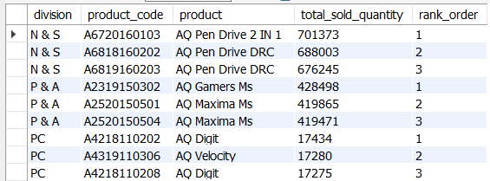
10. Get the Top 3 products in each division that have a high total_sold_quantity in the fiscal_year 2021? The final output contains these fields: division, product_code product total_sold_quantity rank_order
Insight:
Every division has a product with different variants that appears twice in the top three products by division list.

Slide 18
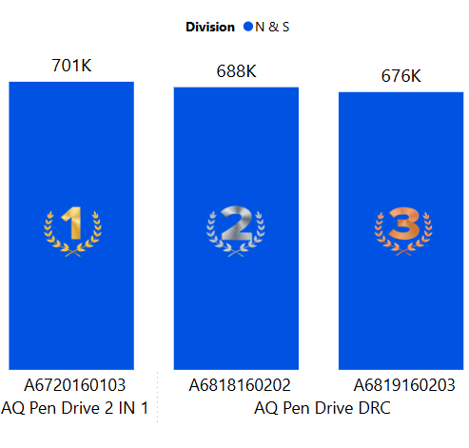
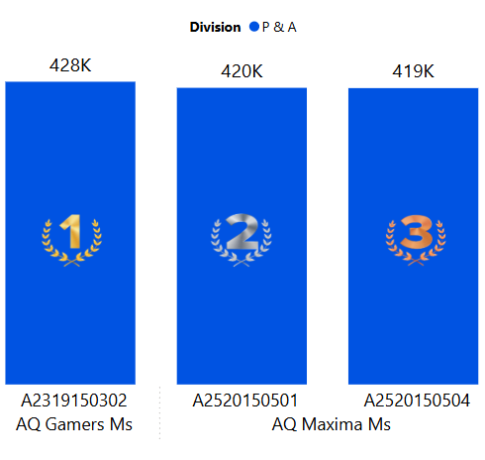
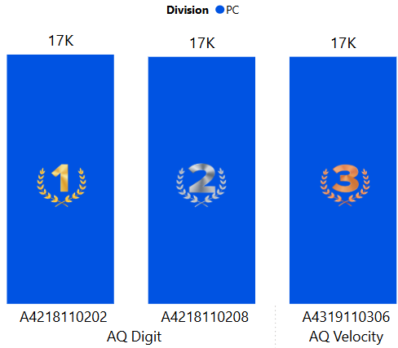

Slide 19

Thank you

